Slide 1
Multi-Omics Factor Analysis a framework for unsupervised integration of multi-omics data sets
Speaker: Jeff Ho

Slide 2
Introduction
Integrative analyses use information across these data modalities promise to deliver more comprehensive insights into the biological systems.
Appealing if the relevant information is not known as a priori. → Missed by a single data mode
Multi-omics profiling is increasingly applied across biological domains
Cancer biology
Regulatory genomics
Microbiology
Host-pathogen biology
Recently, multi-omics analyses at single-cell analysis
These applications ➔ Characterize heterogeneity between samples.

Slide 3
Introduction
Basic strategy for the integration of omics data:
Testing for marginal associations between different data modalities, such as molecular quantitative trait locus mapping.
→ Useful for variant annotation
→ Cannot provide a coherent global map of the molecular differences between samples.
The use of kernel- or graph-based methods to combine different data types into a common similarity network between samples
→ Difficult to pinpoint the molecular determinants of the resulting graph structure.
The shortage of current methods
Cannot reconstruct the underlying factors (such as continuous gradients, discrete clusters, or both) that drive the observed variation across samples. → Interpretability
Estimated features lack sparsity → Reduce interpretability
Require a substantial number of parameters → computationally demanding
Cannot handle missing values and non-Gaussian data modalities (Binary readouts or count-based traits) → Inflexibility for large data sets

Slide 4
Introduction
Multi-Omics Factor Analysis (MOFA)
A statistical method for integrating multiple modalities of omics data in an unsupervised fashion.
A versatile and statistically rigorous generalization of principal component analysis (PCA) to multi-omics data.
Builds upon the statistical framework of Group Factor Analysis (GFA).
Results of the MOFA
Variance decomposition by factors.
Downstream analysis.
Visualization, clustering, classification of samples in the low-dimensional spaces.
Automated annotation of factors using gene set enrichment analysis
The identification of outliers samples.
Imputation of missing values.

Slide 5
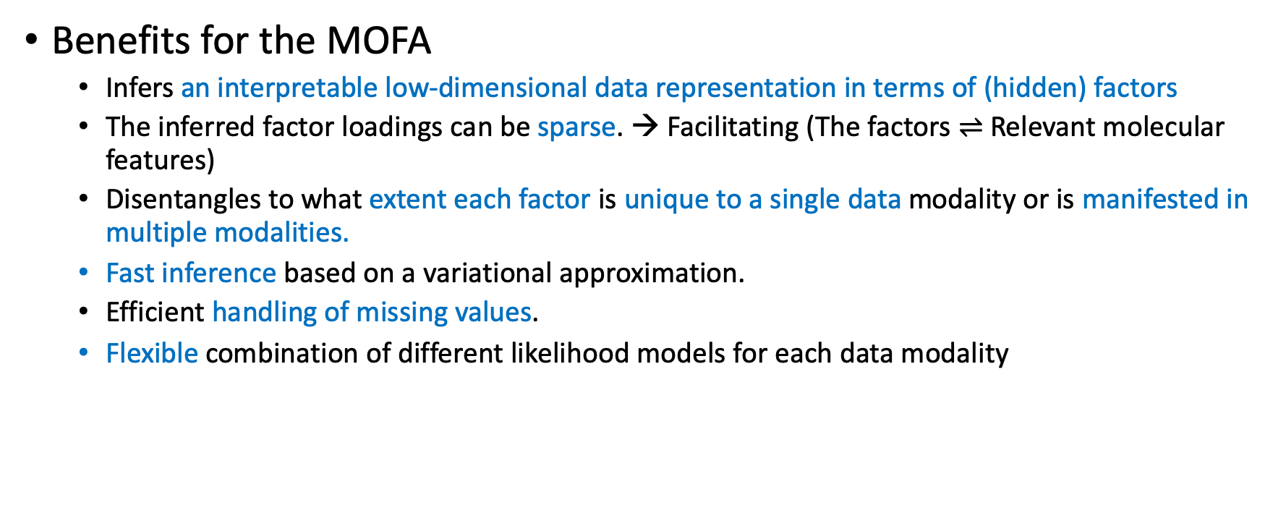
Introduction
Benefits for the MOFA
Infers an interpretable low-dimensional data representation in terms of (hidden) factors
The inferred factor loadings can be sparse. → Facilitating (The factors $⇌$ Relevant molecular features)
Disentangles to what extent each factor is unique to a single data modality or is manifested in multiple modalities.
Fast inference based on a variational approximation.
Efficient handling of missing values.
Flexible combination of different likelihood models for each data modality

Slide 6
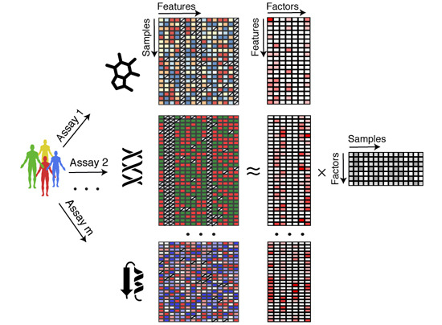
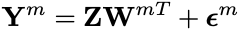
Methods
MOFA models
Factor Analysis: Reduce the dimensionality of a (big) dataset into a small set of variables which are easier to interpret and visualize.
Sample size: N (n)
Feature numbers: D (d)
Data matrices, view: M (m)
Factor matrix (matrix that contains the low-dimensional latent variables.): Z
Loading matrix, weight matrix: W^{m}
Residual noise (its form depends on the specific of the data type): ε^{m}
The expectation of x under the distribution q. (E_{q}[x]): ⟨x⟩
Model:
A Bayesian framework is used. (Place prior dist. on Z, W^{m}, ε^{m})
Y^{m}
W^{m}
Z

Slide 7
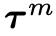
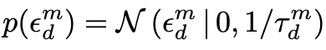
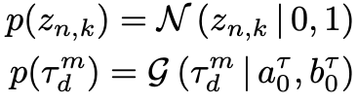
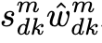
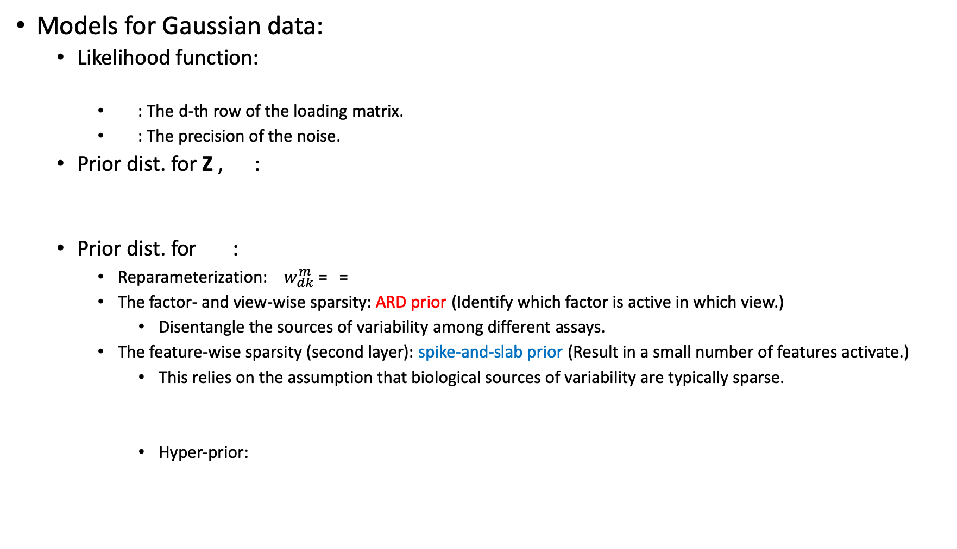
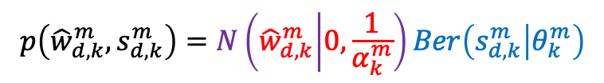
Methods
Models for Gaussian data:
Likelihood function:
: The d-th row of the loading matrix.
: The precision of the noise.
Prior dist. for Z , :
Prior dist. for :
Reparameterization: $w_{dk}^{m}$ = =
The factor- and view-wise sparsity: ARD prior (Identify which factor is active in which view.)
Disentangle the sources of variability among different assays.
The feature-wise sparsity (second layer): spike-and-slab prior (Result in a small number of features activate.)
This relies on the assumption that biological sources of variability are typically sparse.
Hyper-prior:
$$p\left({\hat{w}}_{d,k}^{m}, s_{d,k}^{m}\right)=N\left({\hat{w}}_{d,k}^{m} | 0,\frac{1}{α_{k}^{m}}\right)Ber\left(s_{d,k}^{m} | θ_{k}^{m}\right)$$
$p\left(θ_{k}^{m}\right)=Beta(θ_{k}^{m}|a_{0}^{θ},b_{0}^{θ})$, $p\left(α_{k}^{m}\right)=Gamma(α_{k}^{m}|a_{0}^{α},b_{0}^{α})$

Slide 8
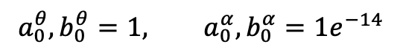
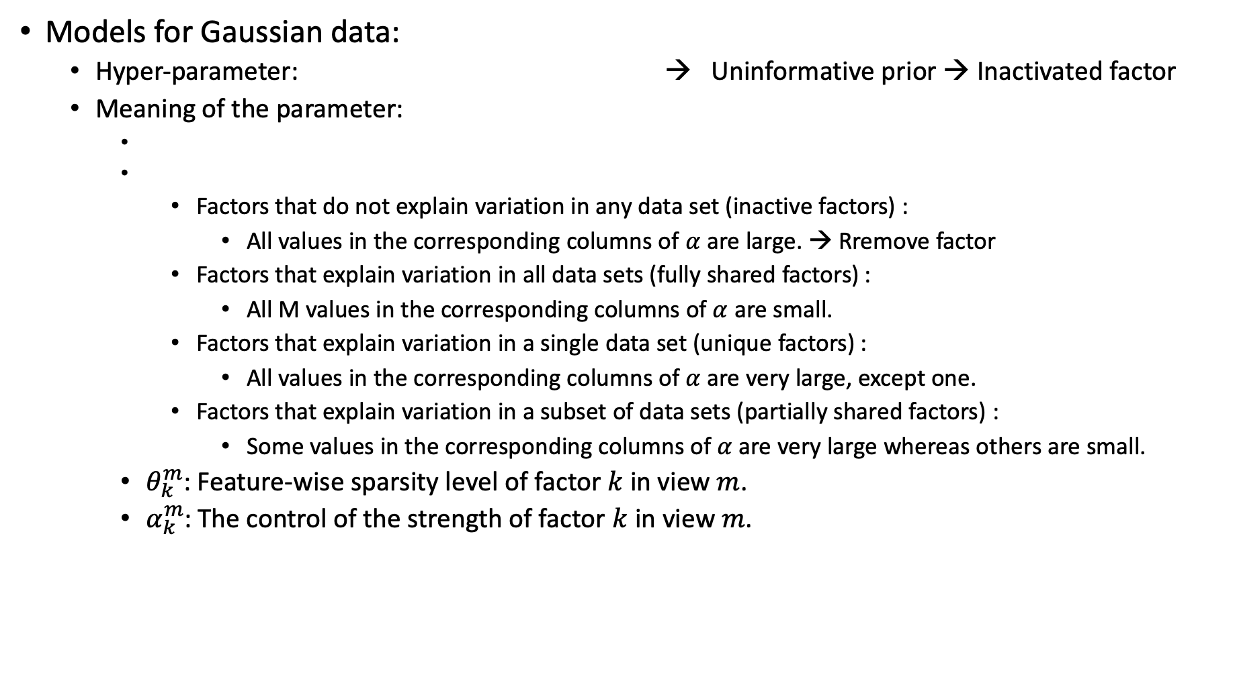
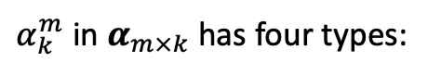
Methods
Models for Gaussian data:
Hyper-parameter: → Uninformative prior → Inactivated factor
Meaning of the parameter:
Factors that do not explain variation in any data set (inactive factors) :
All values in the corresponding columns of $α$ are large. → Rremove factor
Factors that explain variation in all data sets (fully shared factors) :
All M values in the corresponding columns of $α$ are small.
Factors that explain variation in a single data set (unique factors) :
All values in the corresponding columns of $α$are very large, except one.
Factors that explain variation in a subset of data sets (partially shared factors) :
Some values in the corresponding columns of $α$ are very large whereas others are small.
$θ_{k}^{m}$: Feature-wise sparsity level of factor $k$ in view $m$.
$α_{k}^{m}$: The control of the strength of factor $k$ in view $m$.
$$a_{0}^{θ},b_{0}^{θ}=1, a_{0}^{α},b_{0}^{α}=1e^{−14}$$
$θ_{k}^{m}$ close to 0 (1) → Most of the weights of factor k in view m are shrunk to 0. → A (non) sparse factor.
$α_{k}^{m}$ in $α_{m×k}$has four types:

Slide 9
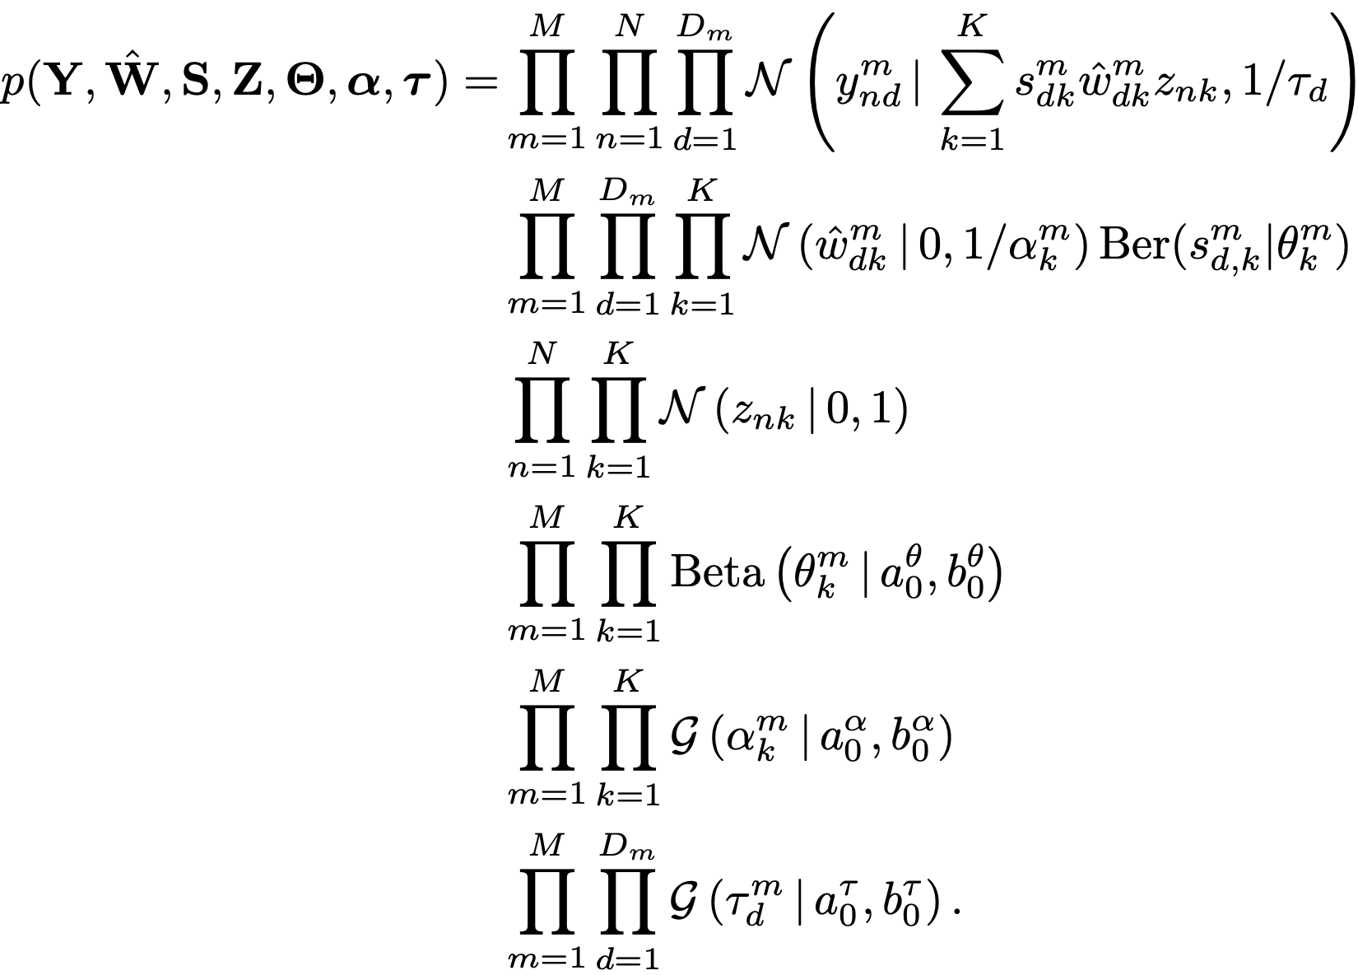
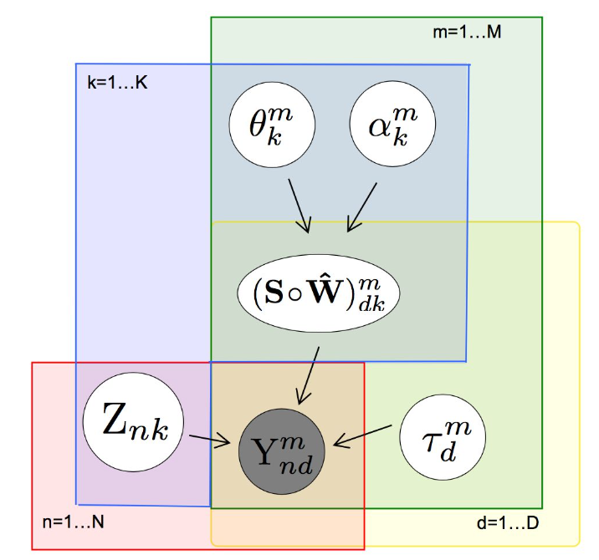
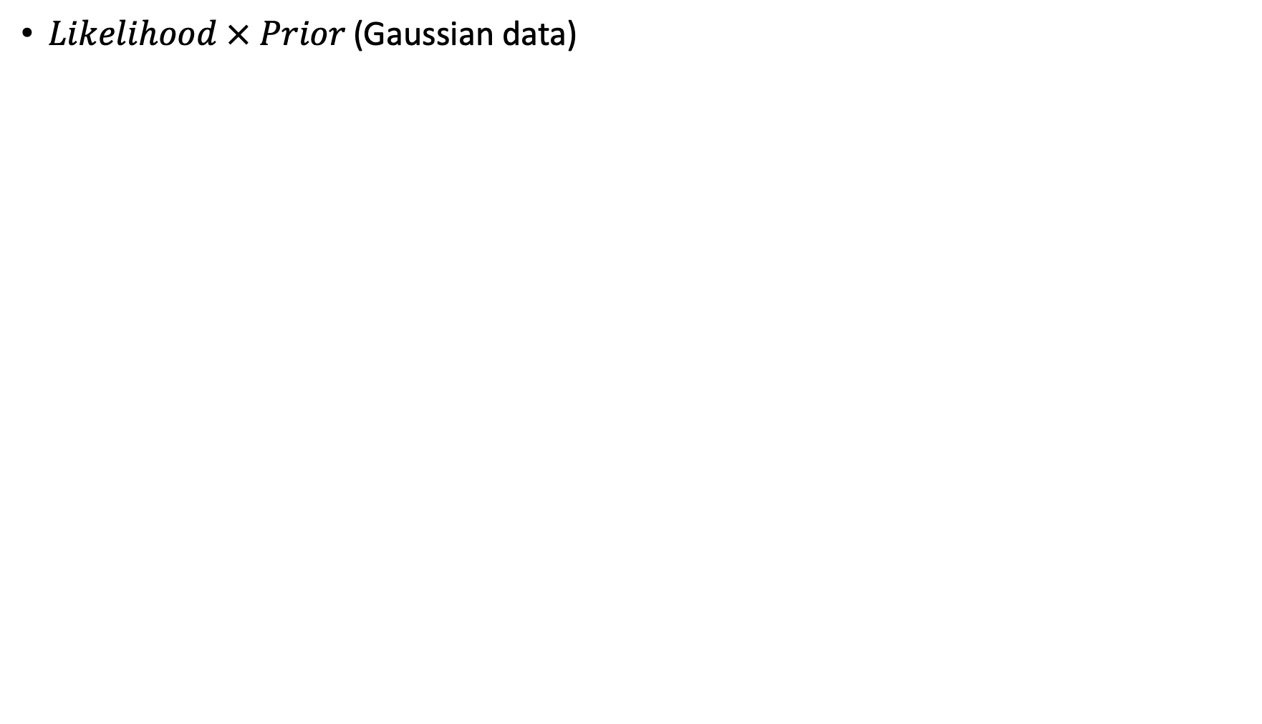
Methods
$Likelihood × Prior$ (Gaussian data)

Slide 10
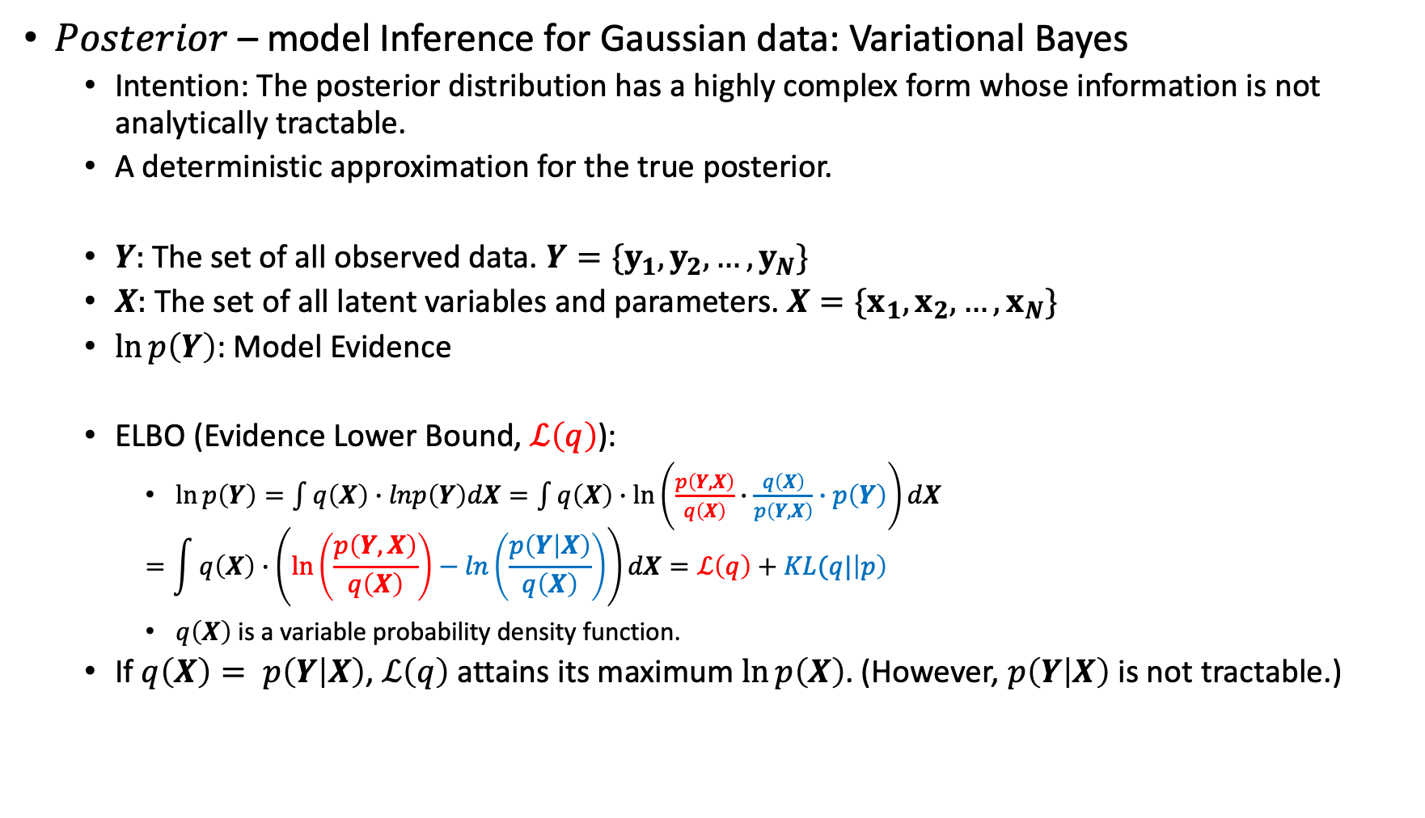
Methods
$Posterior$ – model Inference for Gaussian data: Variational Bayes
Intention: The posterior distribution has a highly complex form whose information is not analytically tractable.
A deterministic approximation for the true posterior.
$Y:$ The set of all observed data. $Y=\{y_{1},y_{2},…,y_{N}\}$
$X:$ The set of all latent variables and parameters. $X=\{x_{1},x_{2},…,x_{N}\}$
$\ln{p\left(Y\right)}$: Model Evidence
ELBO (Evidence Lower Bound, $ℒ\left(q\right)$):
$\ln{p\left(Y\right)}=\int{q\left(X\right)}∙lnp\left(Y\right)dX=\int{q\left(X\right)∙\ln\left(\frac{p\left(Y, X\right)}{q\left(X\right)}∙\frac{q\left(X\right)}{p\left(Y, X\right)}∙p\left(Y\right)\right)dX}$
$$=\int{q\left(X\right)∙\left(\ln\left(\frac{p\left(Y, X\right)}{q\left(X\right)}\right)−ln\left(\frac{p\left(Y | X\right)}{q\left(X\right)}\right)\right)dX}=ℒ\left(q\right)+KL(q|\left|p\right)$$
$q\left(X\right)$ is a variable probability density function.
If $q\left(X\right)= p\left(Y | X\right)$, $ℒ\left(q\right)$ attains its maximum $\ln{p\left(X\right)}$. (However, $p\left(Y | X\right)$ is not tractable.)

Slide 11
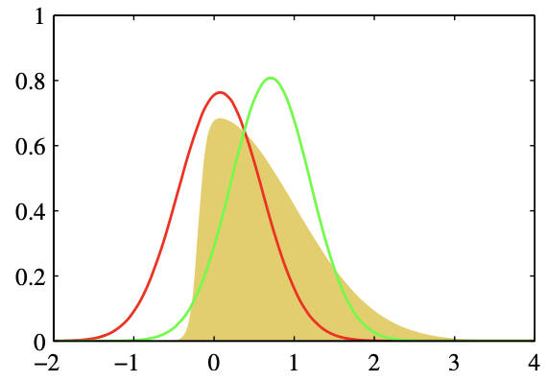
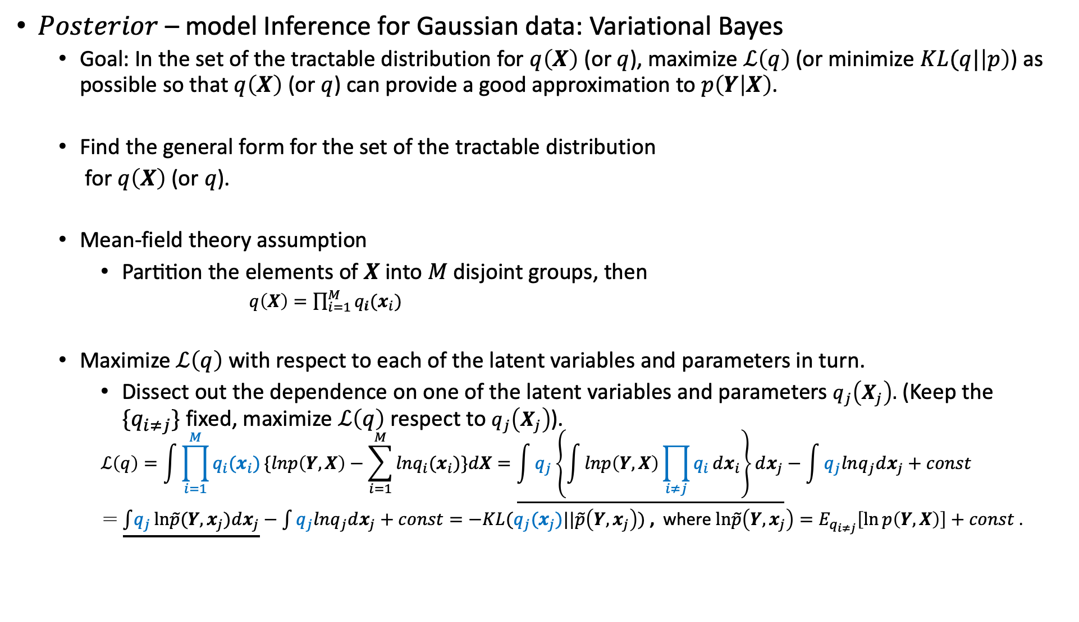
Methods
$Posterior$ – model Inference for Gaussian data: Variational Bayes
Goal: In the set of the tractable distribution for $q\left(X\right)$ (or $q$), maximize $ℒ\left(q\right)$ (or minimize $KL(q|\left|p\right)$) as possible so that $q\left(X\right)$ (or $q$) can provide a good approximation to $p\left(Y | X\right)$.
Find the general form for the set of the tractable distribution
for $q\left(X\right)$ (or $q$).
Mean-field theory assumption
$\text{P}\text{artition} \text{the} \text{elements} \text{of} X \text{into} M \text{disjoint} \text{groups}\text{,}$ then
$q\left(X\right)=\prod_{i=1}^{M}{q_{i}(x_{i})}$
Maximize $ℒ\left(q\right)$ with respect to each of the latent variables and parameters in turn.
Dissect out the dependence on one of the latent variables and parameters $q_{j}\left(X_{j}\right).$ (Keep the ${\{q}_{i≠j}\}$fixed, maximize $ℒ\left(q\right)$ respect to $q_{j}\left(X_{j}\right)$).
$$ℒ\left(q\right)=\int{\prod_{i=1}^{M}{q_{i}(x_{i})}\{lnp\left(Y, X\right)−\sum_{i=1}^{M}{lnq_{i}(x_{i})}\}dX}=\underline{\int{q_{j}\left\{\int{lnp\left(Y, X\right)\prod_{i≠j}{q_{i}}dx_{i}}\right\}dx_{j}}}−\int{q_{j}lnq_{j}dx_{j}}+const$$
$＝\underline{\int{q_{j}}ln\tilde{p}(Y, x_{j})dx_{j}}−\int{q_{j}lnq_{j}dx_{j}}+const=−KL(q_{j}(x_{j})||\tilde{p}\left(Y, x_{j}\right))$ , where $ln\tilde{p}\left(Y, x_{j}\right)=E_{q_{i≠j}}\left[\ln{p\left(Y, X\right)}\right]+const$ .

Slide 12
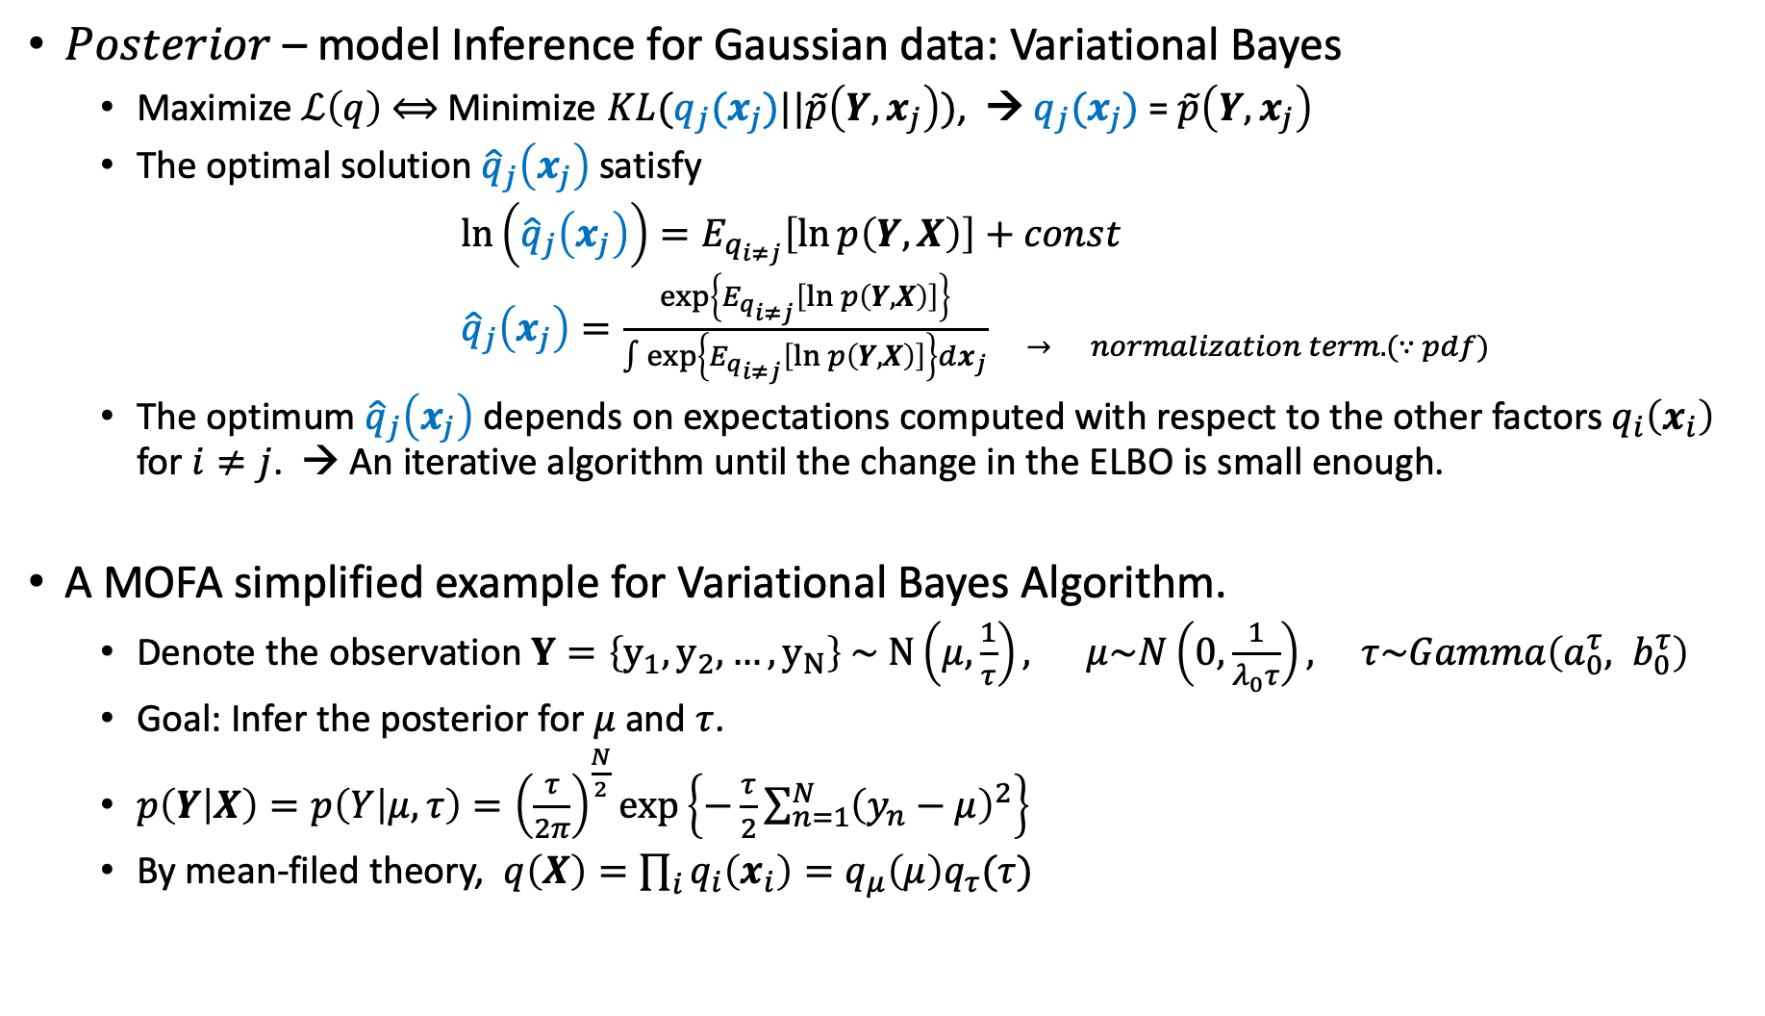
Methods
$Posterior$ – model Inference for Gaussian data: Variational Bayes
Maximize $ℒ\left(q\right)$ $⟺$ Minimize $KL(q_{j}(x_{j})||\tilde{p}\left(Y, x_{j}\right))$, → $q_{j}(x_{j})$ = $\tilde{p}\left(Y, x_{j}\right)$
The optimal solution ${\hat{q}}_{j}\left(x_{j}\right)$ satisfy
$ln\left({\hat{q}}_{j}\left(x_{j}\right)\right)=E_{q_{i≠j}}\left[\ln{p\left(Y, X\right)}\right]+const$
${\hat{q}}_{j}\left(x_{j}\right)=\frac{\exp\left\{E_{q_{i≠j}}\left[\ln{p\left(Y, X\right)}\right]\right\}}{\int{\exp\left\{E_{q_{i≠j}}\left[\ln{p\left(Y, X\right)}\right]\right\}dx_{j}}}{ \atop → normalization term. (∵ pdf)}$
The optimum ${\hat{q}}_{j}\left(x_{j}\right)$ depends on expectations computed with respect to the other factors $q_{i}\left(x_{i}\right)$ for $i≠j$. → An iterative algorithm until the change in the ELBO is small enough.
A MOFA simplified example for Variational Bayes Algorithm.
Denote the observation $Y=\left\{y_{1}, y_{2},…,y_{N}\right\} \sim N\left(μ,\frac{1}{τ}\right), μ\sim N\left(0,\frac{1}{λ_{0}τ}\right), τ\sim Gamma\left(a_{0}^{τ}, b_{0}^{τ}\right)$
Goal: Infer the posterior for $μ$ and $τ$.
$p\left(Y | X\right)=p\left(Y | μ, τ\right)={\left(\frac{τ}{2π}\right)}^{\frac{N}{2}}\exp\left\{−\frac{τ}{2}\sum_{n=1}^{N}{{\left(y_{n}−μ\right)}^{2}}\right\}$
By mean-filed theory, $q\left(X\right)=\prod_{i}{q_{i}\left(x_{i}\right)}=q_{μ}\left(μ\right)q_{τ}(τ)$

Slide 13
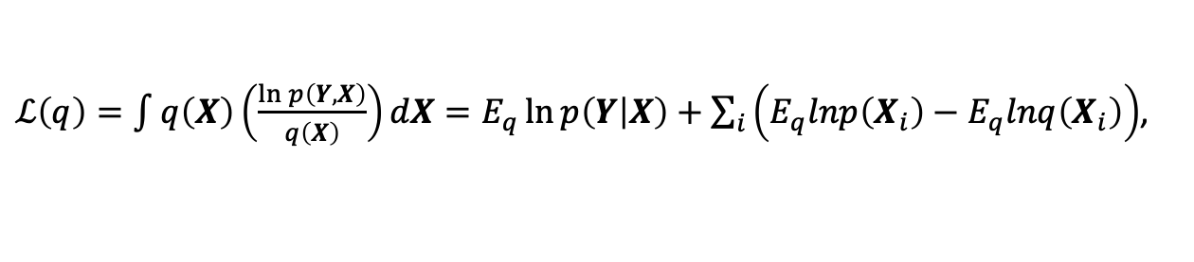
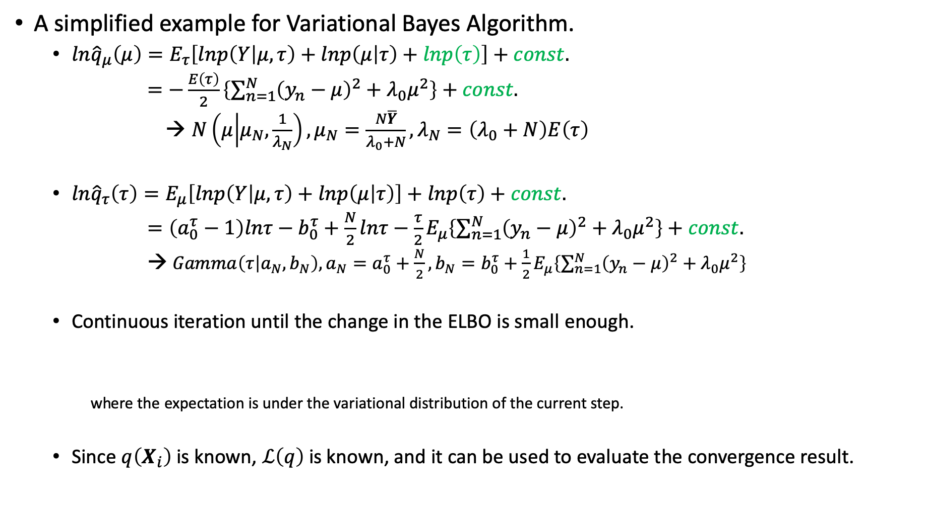
Methods
A simplified example for Variational Bayes Algorithm.
$ln{\hat{q}}_{μ}\left(μ\right)=E_{τ}\left[lnp\left(Y | μ, τ\right)+lnp\left(μ | τ\right)+lnp\left(τ\right)\right]+const.$
$=−\frac{E\left(τ\right)}{2}\left\{\sum_{n=1}^{N}{{\left(y_{n}−μ\right)}^{2}+λ_{0}μ^{2}}\right\}+const.$
→ $N\left(μ | μ_{N},\frac{1}{λ_{N}}\right),μ_{N}=\frac{N\overline{Y}}{λ_{0}+N},λ_{N}=\left(λ_{0}+N\right)E\left(τ\right)$
$ln{\hat{q}}_{τ}\left(τ\right)=E_{μ}\left[lnp\left(Y | μ, τ\right)+lnp\left(μ | τ\right)\right]+lnp\left(τ\right)+const.$
$=\left(a_{0}^{τ}−1\right)lnτ−b_{0}^{τ}+\frac{N}{2}lnτ−\frac{τ}{2}E_{μ}\left\{\sum_{n=1}^{N}{{\left(y_{n}−μ\right)}^{2}+λ_{0}μ^{2}}\right\}+const.$
→ $Gamma\left(τ | a_{N},b_{N}\right),a_{N}=a_{0}^{τ}+\frac{N}{2},b_{N}=b_{0}^{τ}+\frac{1}{2}E_{μ}\left\{\sum_{n=1}^{N}{{\left(y_{n}−μ\right)}^{2}+λ_{0}μ^{2}}\right\}$
Continuous iteration until the change in the ELBO is small enough.
where the expectation is under the variational distribution of the current step.
Since $q\left(X_{i}\right)$ is known, $ℒ\left(q\right)$ is known, and it can be used to evaluate the convergence result.
$ℒ\left(q\right)=\int{q\left(X\right)\left(\frac{\ln{p\left(Y, X\right)}}{q\left(X\right)}\right)dX}=E_{q}\ln{p\left(Y | X\right)}+\sum_{i}{\left(E_{q}lnp\left(X_{i}\right)−E_{q}lnq\left(X_{i}\right)\right)}$,

Slide 14
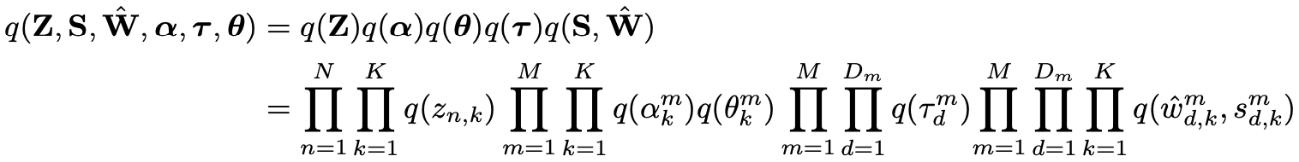
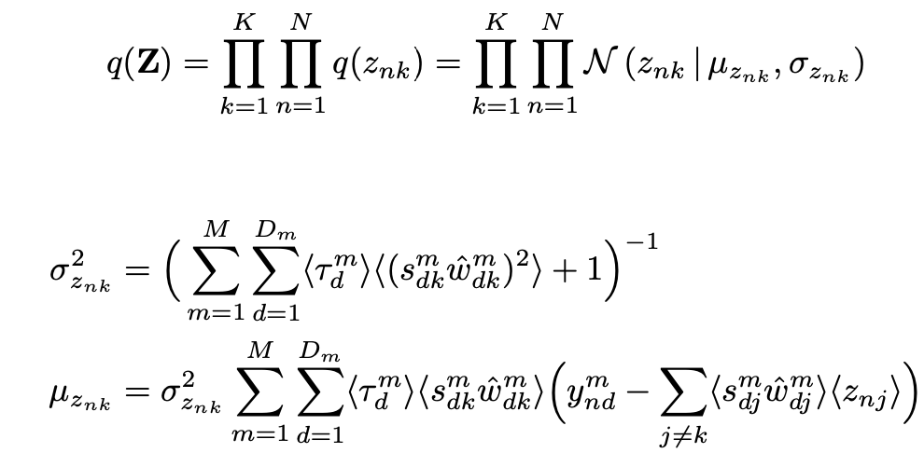
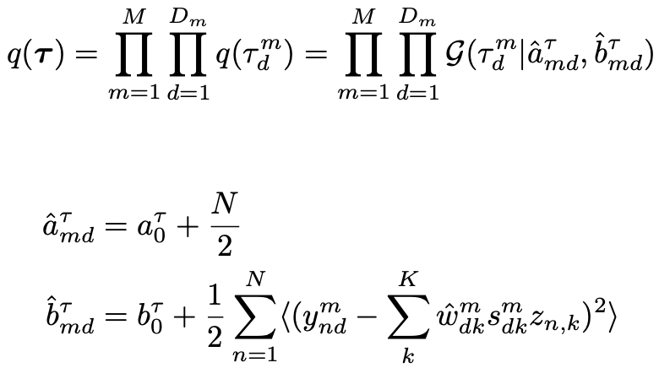
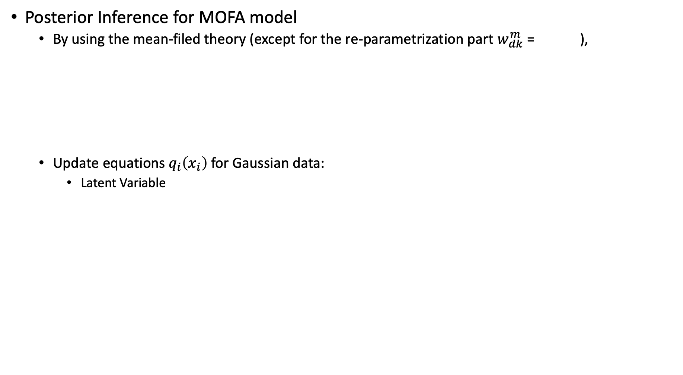
Methods
Posterior Inference for MOFA model
By using the mean-filed theory (except for the re-parametrization part $w_{dk}^{m}$ = ),
Update equations $q_{i}\left(x_{i}\right)$ for Gaussian data:
Latent Variable
Noise precision

Slide 15
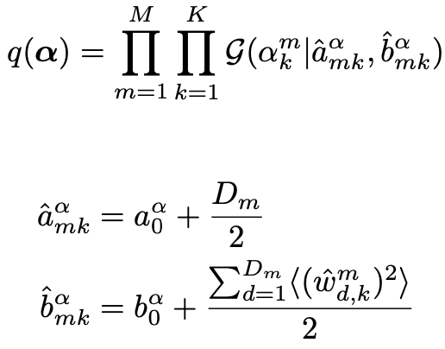
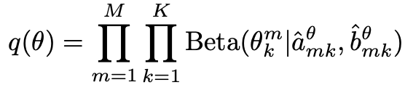
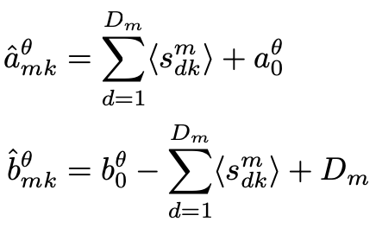
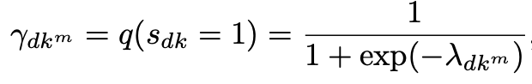
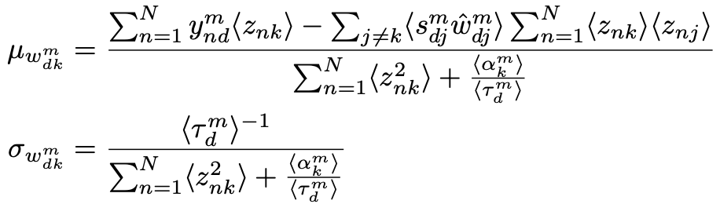
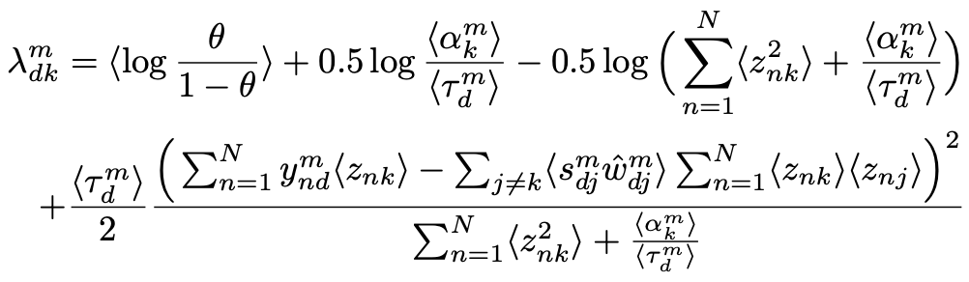
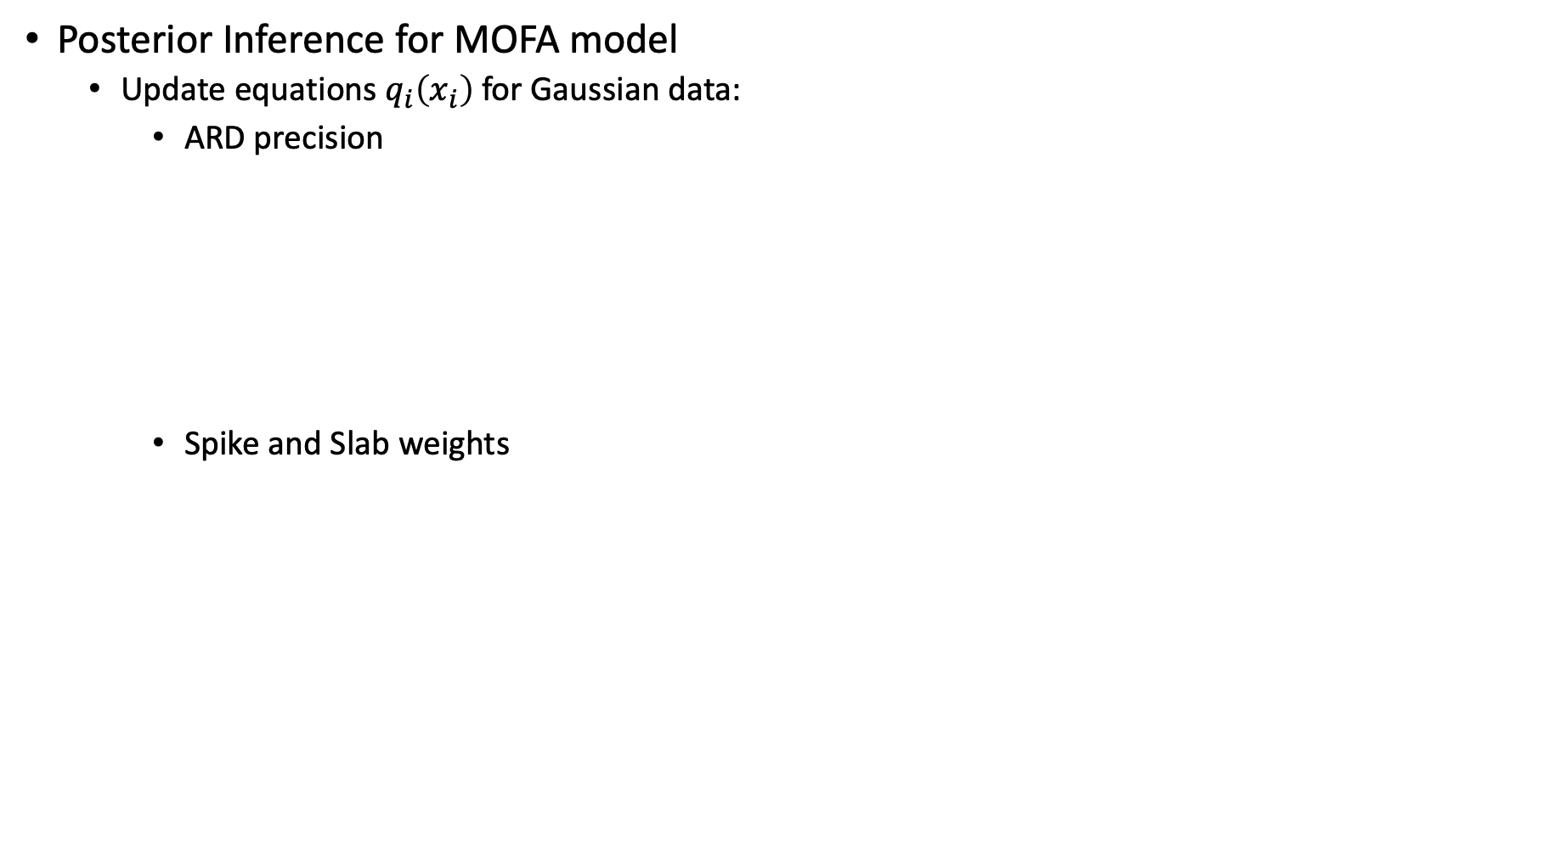
Methods
Posterior Inference for MOFA model
Update equations $q_{i}\left(x_{i}\right)$ for Gaussian data:
ARD precision
Spike and Slab weights
Spike and Slab sparsity parameter

Slide 16
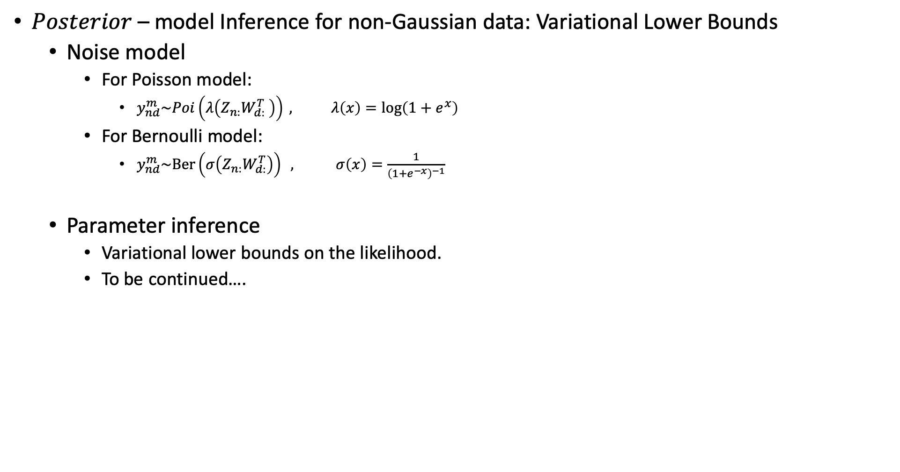
Methods
$Posterior$ – model Inference for non-Gaussian data: Variational Lower Bounds
Noise model
For Poisson model:
$y_{nd}^{m}\sim Poi\left(λ\left(Z_{n:}W_{d:}^{T} \right)\right) , λ\left(x\right)=\log\left(1+e^{x}\right)$
For Bernoulli model:
$y_{nd}^{m}\sim Ber\left(σ\left(Z_{n:}W_{d:}^{T}\right)\right) , σ\left(x\right)=\frac{1}{{\left(1+e^{−x}\right)}^{−1}}$
Parameter inference
Variational lower bounds on the likelihood.
To be continued….

Slide 17
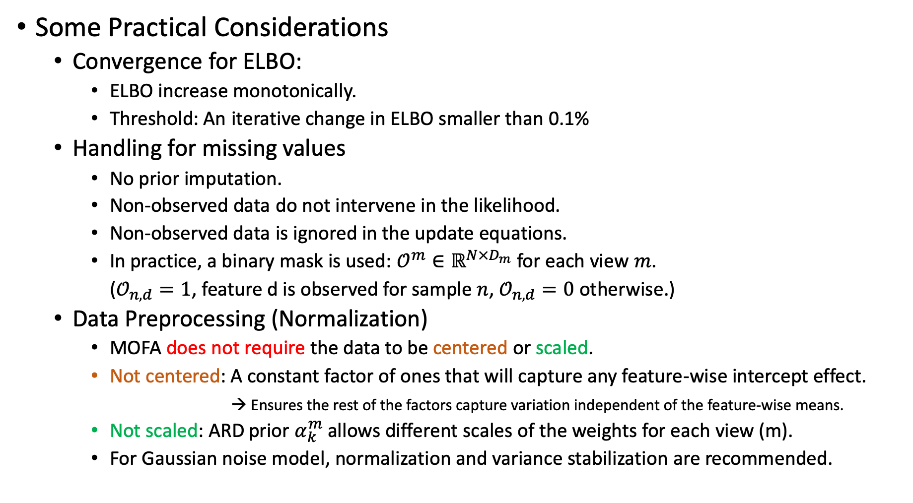
Methods
Some Practical Considerations
Convergence for ELBO:
ELBO increase monotonically.
Threshold: An iterative change in ELBO smaller than 0.1%
Handling for missing values
No prior imputation.
Non-observed data do not intervene in the likelihood.
Non-observed data is ignored in the update equations.
In practice, a binary mask is used: $𝒪^{m}∈ℝ^{N×D_{m}}$for each view $m$.
($𝒪_{n, d}=1$, feature d is observed for sample $n$, $𝒪_{n, d}=0$ otherwise.)
Data Preprocessing (Normalization)
MOFA does not require the data to be centered or scaled.
Not centered: A constant factor of ones that will capture any feature-wise intercept effect.
→ Ensures the rest of the factors capture variation independent of the feature-wise means.
Not scaled: ARD prior $α_{k}^{m}$ allows different scales of the weights for each view (m).
For Gaussian noise model, normalization and variance stabilization are recommended.

Slide 18
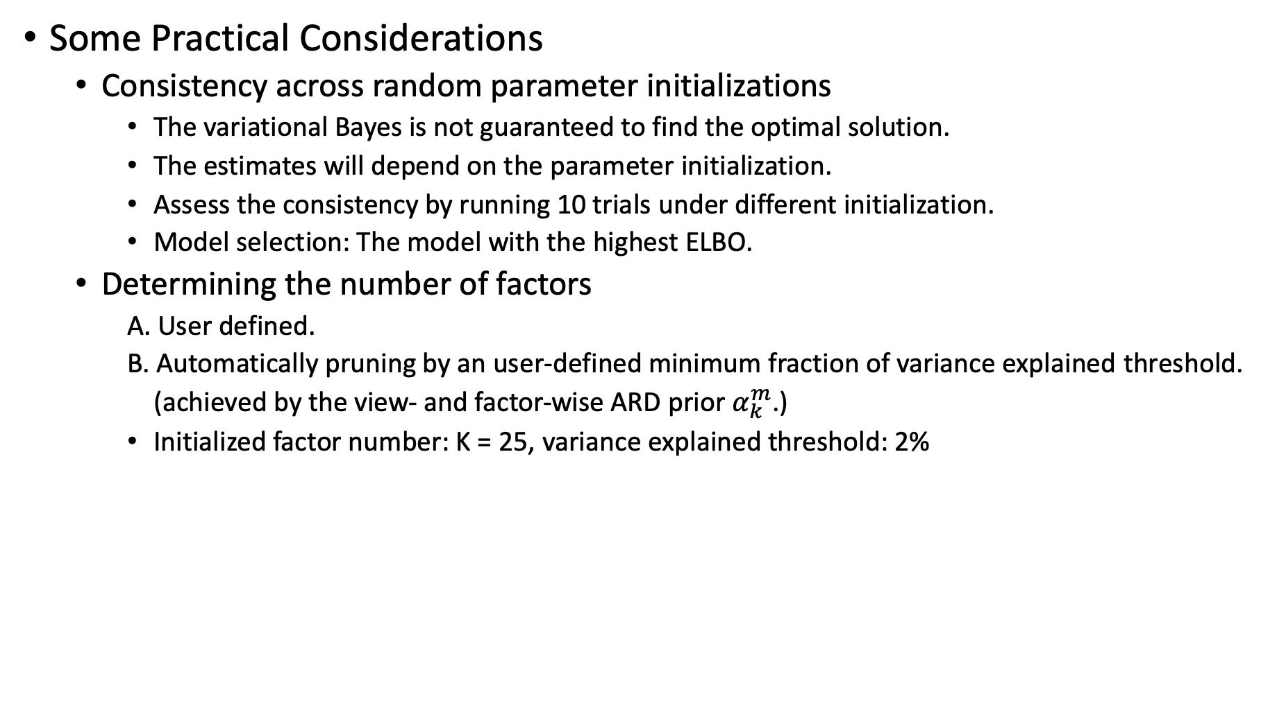
Methods
Some Practical Considerations
Consistency across random parameter initializations
The variational Bayes is not guaranteed to find the optimal solution.
The estimates will depend on the parameter initialization.
Assess the consistency by running 10 trials under different initialization.
Model selection: The model with the highest ELBO.
Determining the number of factors
A. User defined.
B. Automatically pruning by an user-defined minimum fraction of variance explained threshold.
(achieved by the view- and factor-wise ARD prior $α_{k}^{m}$.)
Initialized factor number: K = 25, variance explained threshold: 2%

Slide 19
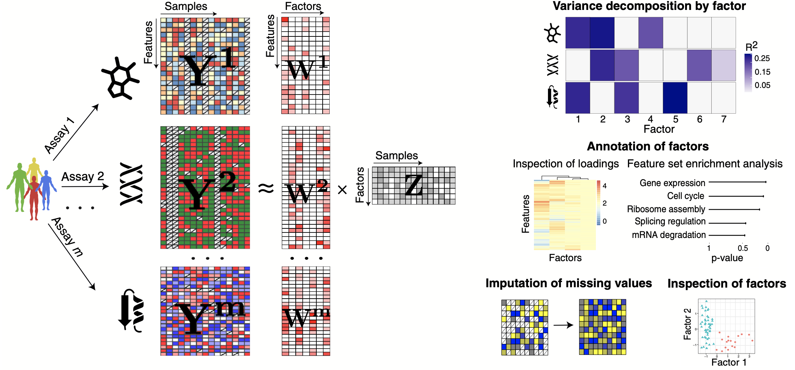
Methods
Downstream analysis

Slide 20
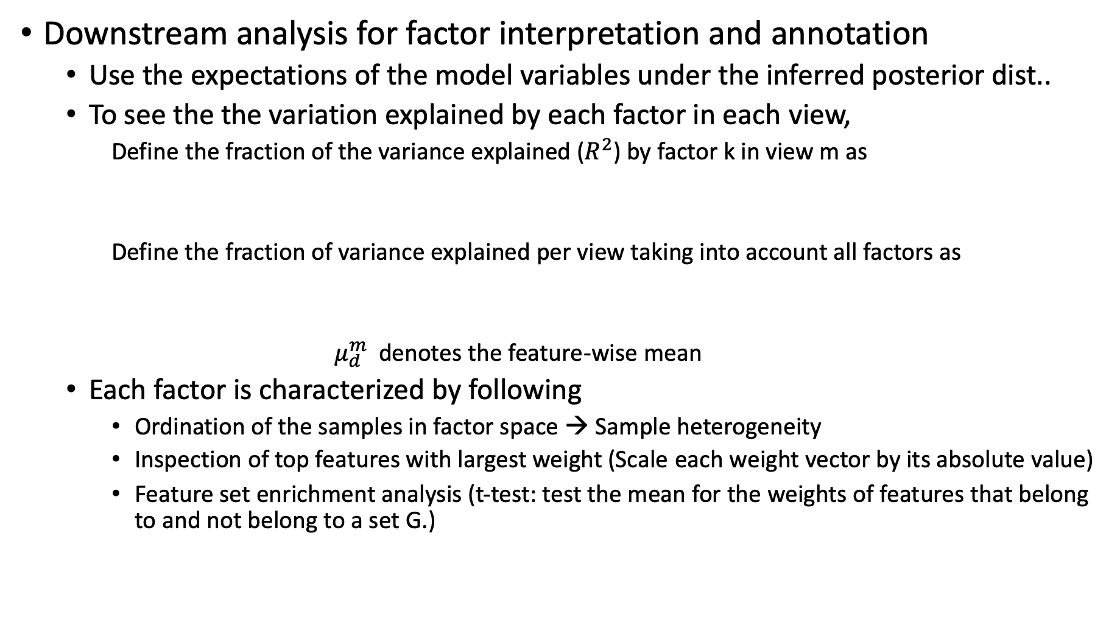
Methods
Downstream analysis for factor interpretation and annotation
Use the expectations of the model variables under the inferred posterior dist..
To see the the variation explained by each factor in each view,
Define the fraction of the variance explained ($R^{2}$) by factor k in view m as
Define the fraction of variance explained per view taking into account all factors as
$μ_{d}^{m}$ denotes the feature-wise mean
Each factor is characterized by following
Ordination of the samples in factor space → Sample heterogeneity
Inspection of top features with largest weight (Scale each weight vector by its absolute value)
Feature set enrichment analysis (t-test: test the mean for the weights of features that belong to and not belong to a set G.)

Slide 21
Methods
Downstream analysis for imputation
In the CLL data,
Use the subset of samples with all measurements (N=121).
Masked data at random either single values or all measurements for randomly selected samples in the drug response.
Trained MOFA on the masked data.
Accuracy: MSE: masked values vs. true values.
Fix the number of factors for MOFA K = 10.
To study the dependence on K for imputation and compare MOFA to GFA, varying K = 1, …, 20 and re-ran the same masking experiments.

Slide 22
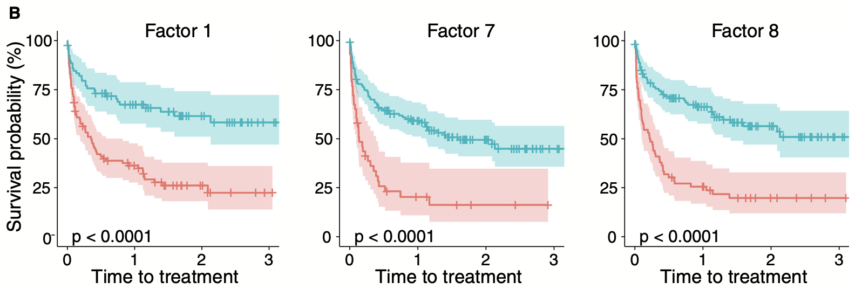
Methods
Downstream analysis for Survival Analysis (Kaplan–Meier plots)
Cut-point for each factor: maximally selected rank statistics with P-values based on a log-rank test between the resulting groups.

Slide 23
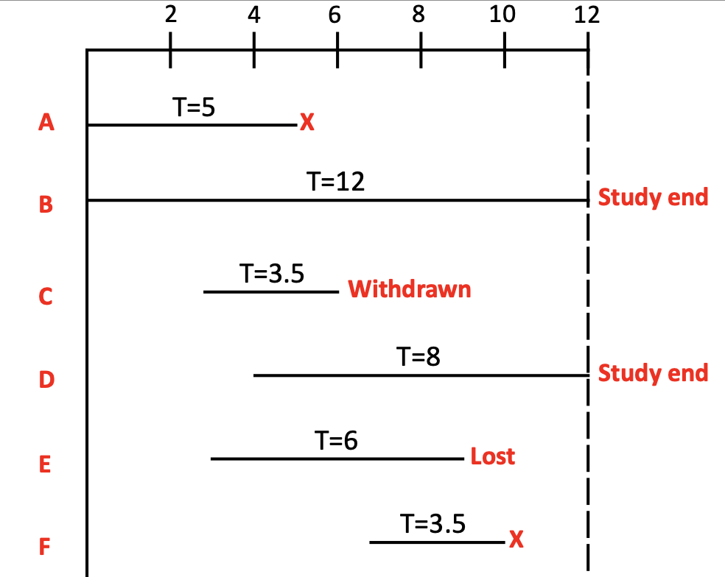
Methods
Censoring data

Slide 24
Methods
Downstream analysis for Survival Analysis (Cox Model)
After the dimensional reduction (MOFA), using these new factors as covariates in the Cox model.
Scaled all predictors to ensure comparability of the hazard ratios.
N = 174, censored data: 78 samples.
Model Comparison:
PCA: 10 principal components for each single view.
MOFA: 10 MOFA factors.
The complete set of all features in a view with a ridge penalty in the Cox model
A stratified fivefold cross-validation scheme.
Evaluation: Harrel’s C-index

Slide 25
Methods
Methods Comparison
iCluster
Primary application: Clustering
It cannot drive variation in distinct subsets of views.
It cannot handle missing values.
Computationally demanding.
Grouped Factor Analysis (GFA)
Only deal with Gaussian observation data.
Use sparsity constraints throughout training → Maintain factors that have near-zero relevance.
Use Gibbs sampling.
Still infer for deactivate factors.
Time-consuming when the data has missing values.

Slide 26
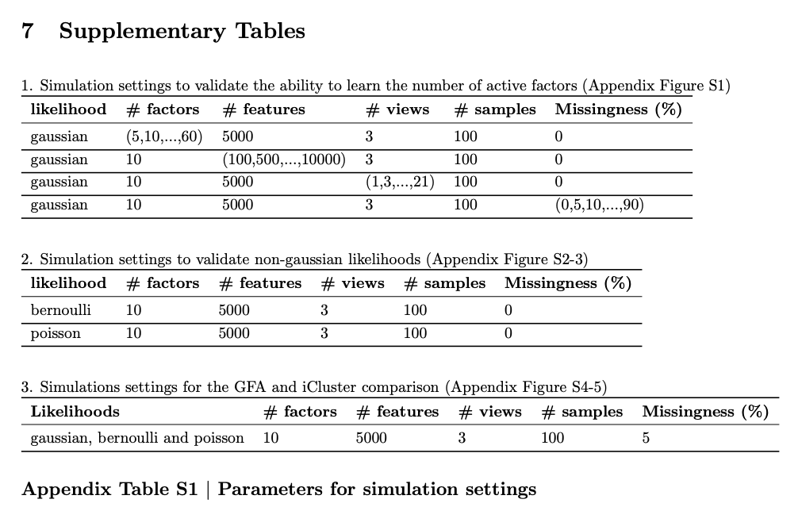
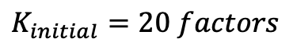
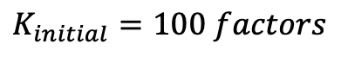
Simulation
Model Validation (Only MOFA)
Simulate data from the generative model
10 repeats for every config.
Evaluation: The estimated number of factors.
$$K_{initial}=100 factors$$
$$K_{initial}=20 factors$$

Slide 27
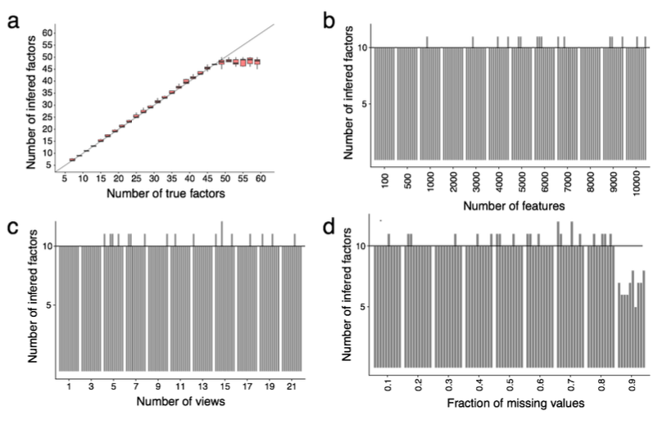
Simulation
Results for model validation (Only MOFA)
Accurately reconstruct the latent dimension, except
Large numbers of factors
$$K_{initial}=100 factors$$
High proportions of missing values
$$K_{initial}=20 factors$$

Slide 28
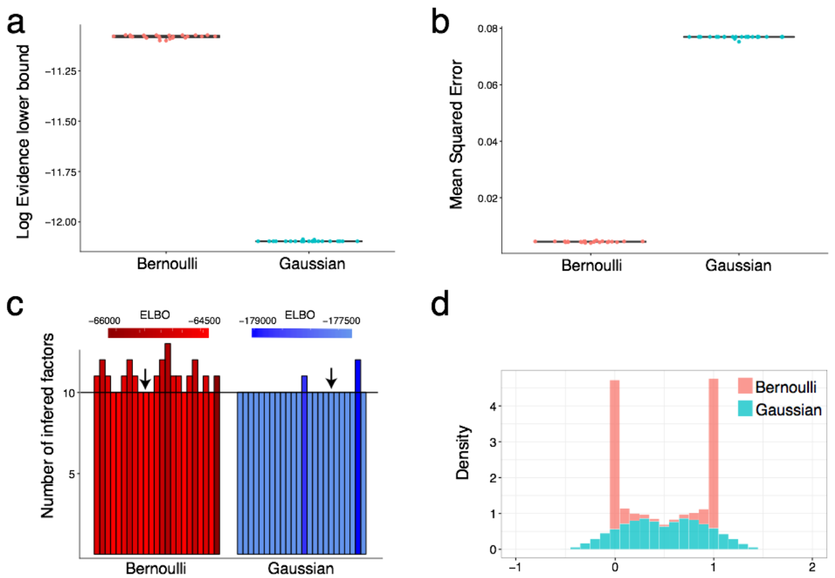
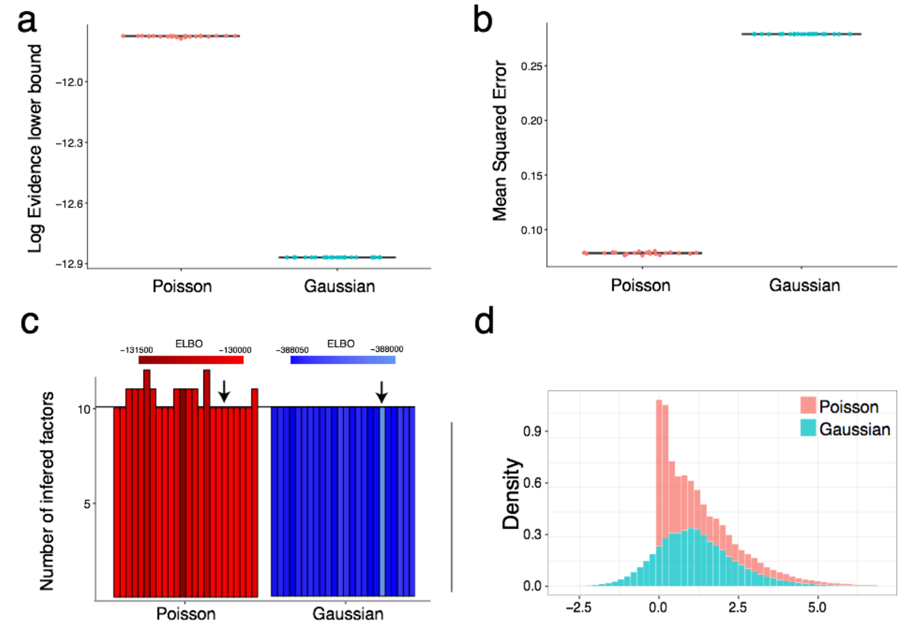




Simulation
Results for model validation (Only MOFA)
Models that account for non- Gaussian observations improved the fit when simulating binary or count data.
Bernoulli
Poisson
$$↑$$
$$↑$$
$$↓$$
$$↓$$
$$K_{initial}=20 factors$$

Slide 29
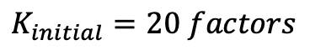
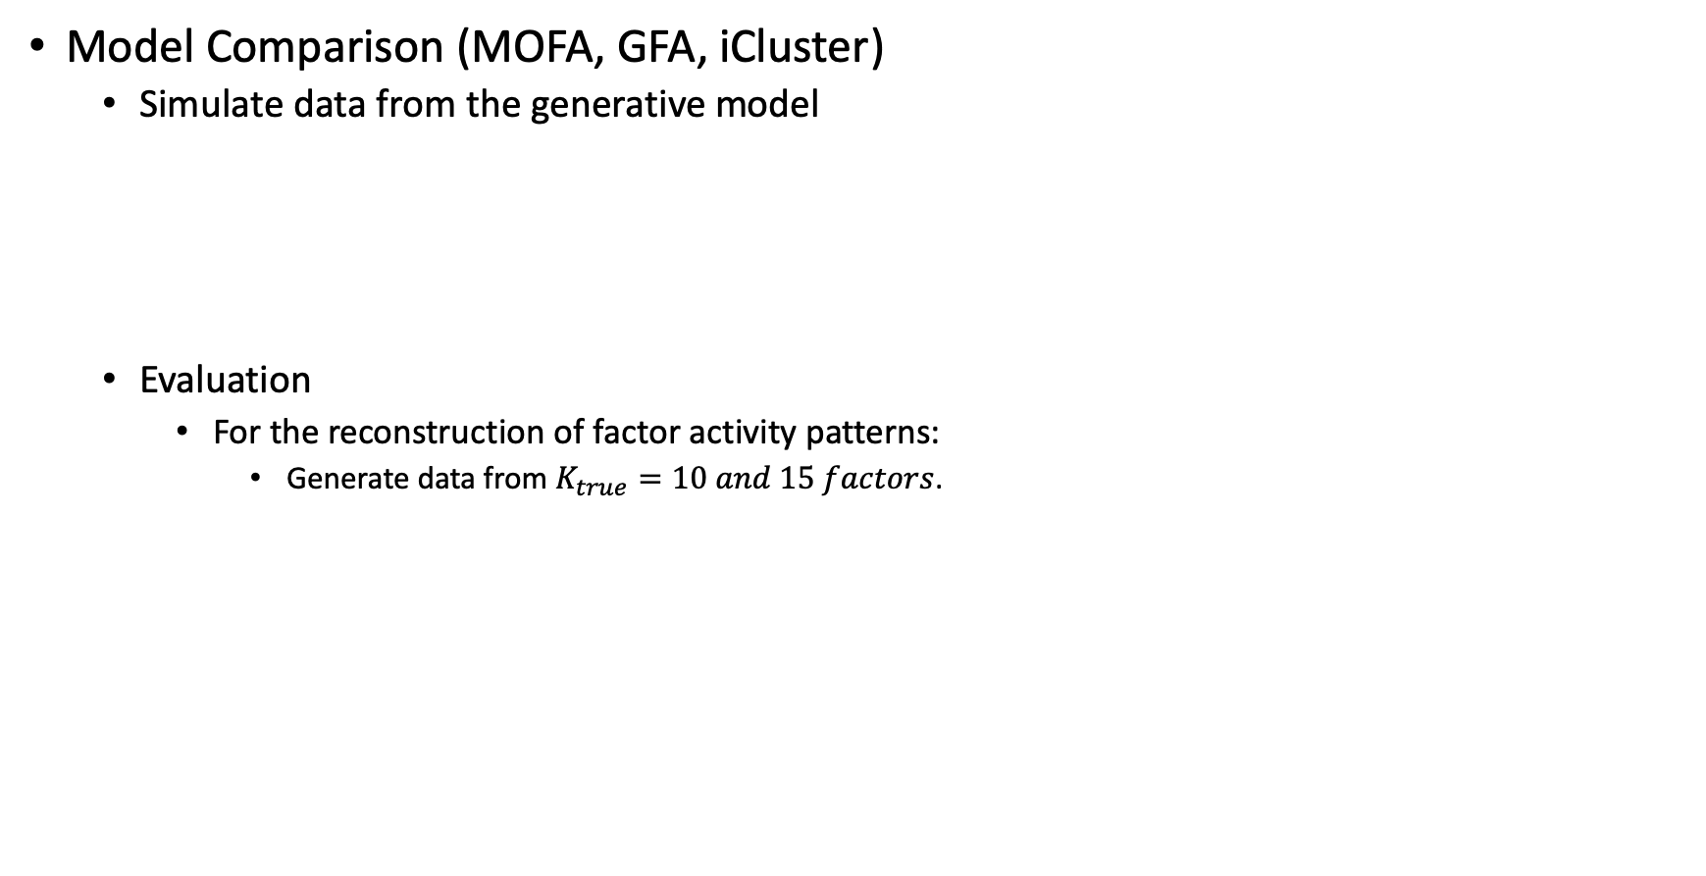
Simulation
Model Comparison (MOFA, GFA, iCluster)
Simulate data from the generative model
Evaluation
For the reconstruction of factor activity patterns:
Generate data from $K_{true}=10 and 15 factors$.
$$K_{initial}=20 factors$$

Slide 30
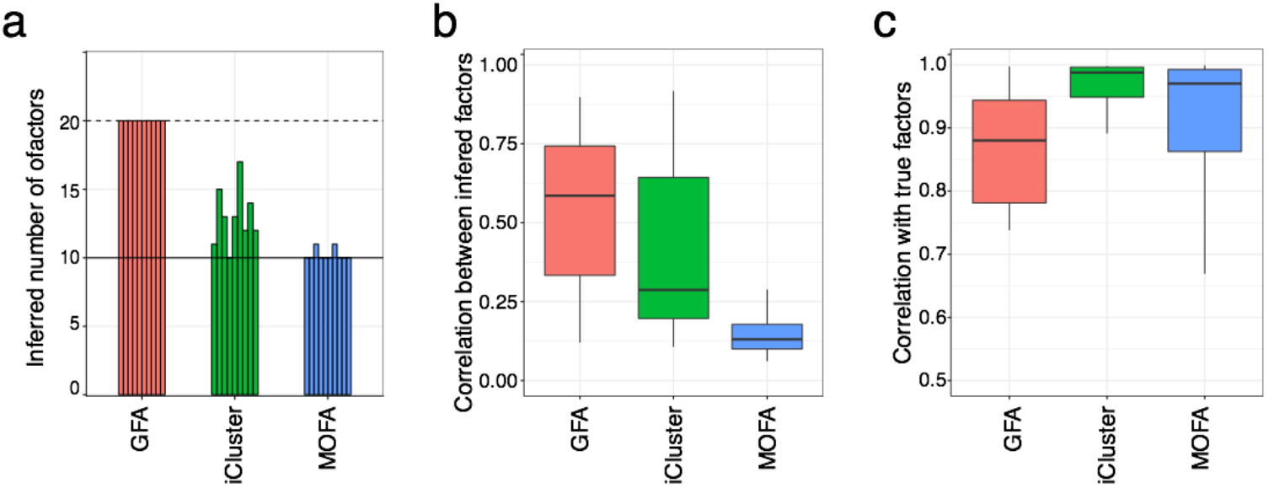

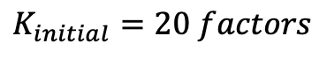
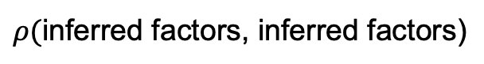



Simulation
Results for model comparison (MOFA, GFA, iCluster)
GFA and iCluster tends to infer redundant factors.
$ρ($inferred factors, inferred factors)
$$↓$$
$$K_{initial}=20 factors$$
$$K_{true}=10 factors$$
$ρ($true factors, inferred factors)
$$↑$$
$$K_{initial}=20 factors$$

Slide 31




Simulation
Results for model comparison (MOFA, GFA, iCluster)
GFA and iCluster were less accurate in recovering patterns of shared factor activity across views.
$$K_{true}=10 factors$$
$$K_{initial}=25 factors$$
$$↑$$
For iCluster, the true number of factors was used
$$K_{true}=15 factors$$
$$K_{initial}=20 factors$$

Slide 32

Real Data Analysis – CLL
Chronic lymphocytic leukemia (CLL)
Data types: (Choosed)
Somatic mutation status. (Mutations)
Transcriptome profiling. (mRNA)
DNA methylation. (Methylation)
Ex vivo drug response measurements. (Drug response)
Nearly 40% of 200 samples data is partially missing.
Consuming Time:
MOFA: 25mins
GFA: 34hrs
iCluster: 5-6 days
2

Slide 33





Real Data Analysis – CLL
S6
10 factors are detected. (variance threshold: 2%)
25 trials (random initializations) are conducted.
Factors are orthogonal. (S6: c, d)
Robustness in algorithm initialization. (S6: a, b, c, d)
Robustness in subsampling of the data. (S7: a, b)
S6
S7

Slide 34



Real Data Analysis – CLL
2
Variance decomposition by factor (2B)
Multiple molecular data modalities: Factor1 and factor2.
Two data modalities: Factor 3 and factor 5.
Single data modality: Factor 4.
Total variation explained (2C)
Drug response: 41%
mRNA: 38%
Methylation: 24%
Mutations: 24%
2

Slide 35


Real Data Analysis – CLL
S8
Factor redundancy (S8: a, b, c, d)
Factors activate in multiple data modalities could still be detected when excluding specific data modality.
S8 a, c: correlation on 121 samples (X-axis: the MOFA factors discovered on the full datasets.)
S8 b, d: prediction for 121 samples based on 10 factors.
S8

Slide 36

Real Data Analysis – CLL
Comparison with GFA and iCluster.
MOFA’s result is more consistent in identifying factors. (S9)
S9
For the first trial of each model (S9 b)
Line in S9 c: 1% FDR

Slide 37

Real Data Analysis – CLL
Downstream Analysis – Annotation of factors
Based on the all data result, (2D, 2E)
Factor 1 ⬄ somatic mutation of the immunoglobulin heavy-chain variable region gene (IGHV)
Factor 2 ⬄ trisomy of chromosome 12
Both factors are aligned with two
of the most important clinical
markers in CLL.
2
2
IGHV: a surrogate of the differentiation state of the tumor's cell of origin and the level of activation of the B-cell receptor.
Base on the mutation data

Slide 38

Real Data Analysis – CLL
Downstream Analysis – Annotation of factors
Based on the drug response and mRNA data result,
Factor 5 ⬄ A set of genes enriched for oxidative stress and senescence pathways.
Based on the mRNA data result only,
Factor 4 ⬄ Immune response pathways and T-cell receptor signaling.
→ Due to differences in cell type composition among samples.
(Mainly all B cells, some are contaminated with T cells and monocytes.)
Based on the drug response data only,
Factor 3 ⬄ Samples’ drug sensitivity.
2

Slide 39


Real Data Analysis – CLL
Downstream Analysis – Annotation of factors
More on the factor 1.
In the clinical data, IGHV status is binary.
→ The value of factor 1 has a more complex substructure. (3A, S10)
3
S10
K-means clustering
3 subgroups
Consistent with
other studies
low factor values (LZ)
Intermediate factor values (IZ)
high factor values (HZ).

Slide 40
Real Data Analysis – CLL
Downstream Analysis – Annotation of factors
More on the factor 1.
MOFA connect this factor to multiple molecular layers. (S12, S13)
Related to the changes in the expression of genes linked to IGHV status. (3B, 3C)
Related to the drugs that target kinases or the downstream of the B-cell receptor pathway (BCR pathway). (3D, 3E)

Slide 41

Figure 3
cellular

Slide 42



S12
S13
$$ρ(F1,individual molecular features)$$
$$ρ(F1 on full data,F1 on partial data modality)$$
drug
response
within cluster $ρ$
gene expression
methylation
Displayed are representative features with high absolute loading on the Factor 1 from the full model.

Slide 43
Real Data Analysis – CLL
Downstream Analysis – Annotation of factors
More on the factor 5.
Based on the mRNA data (EV2B, EV2C)
The top weight pathway: heat-shock proteins (HSPs)
HSPs contains genes that are essential for protein folding and are up-regulated upon stress conditions.
Genes in HSP pathways are up-regulated in some cancers, but receive little attention in the context of CLL.
Based on the drug response data (EV2D, EV2E)
The top weight drug: oxidative stress (e.g. reactive oxygen species (ROS), DNA damage response and apoptosis).

Slide 44

Figure EV2

Slide 45

Real Data Analysis – CLL
Downstream Analysis – Annotation of factors
More on the factor 4.
S14
Important surface markers of T-cells

Slide 46

Real Data Analysis – CLL
Downstream Analysis – Annotation of factors
More on the factor 3.
S15
All drugs and concentrations

Slide 47

Real Data Analysis – CLL
Downstream Analysis – Outlier identification
Infer IGHV status by using factor 1. Among 200 samples (12 missing),
9 samples: Intermediate molecular signatures => borderline cases.
3 samples: molecular signatures discordant. => (EV3C, EV3D, EV3E, EV3F)
Drug Response
Whole exome sequencing data
EV3

Slide 48


Real Data Analysis – CLL
Downstream Analysis – Missing data imputation
MOFA yield a more accurate predictions than other established imputation strategies. (EV4)
The imputation accuracy of MOFA is more robust than GSA (S17)
EV4
drug response
S17
drug response
values missing at random
entire assay missing for
samples at random.

Slide 49
Real Data Analysis – CLL
Prediction of clinical outcomes (time to next treatment)
3 of 10 factors (1, 7, 8) are significantly associated. (Cox regression; 4A, 4B)
Factor 7, 8 are related to chemo-immunotherapy treatment (prior to sample collection)
Factor 7: captures del17p and TP53 mutations as well as differences in methylation patterns of oncogenes. (S18)
Factor 8: associated with WNT signaling. (S19)
Combining the 10 MOFA factors in a multivariate Cox regression model to predict the time.
Higher prediction accuracy than other models, e.g.
Models using conventional PCA components. (4C)
Models using individual molecular features. (S20)
Models using MOFA factors derived from only a subset of the available data modalities. (S8 B, D)
The predictive value is similar to clinical covariates that are used to guide treatment decisions (S21)

Slide 50

Real Data Analysis – CLL
4
4
Log rank test
Univariate Cox models

Slide 51


Real Data Analysis – CLL
S18
Factor 7 annotation
S19
Factor 8 annotation

Slide 52




Real Data Analysis – CLL
S20
4
L​₂-penalized Cox regression models
S8
First 10 PCA components

Slide 53

Real Data Analysis – CLL
S21
Univariate Cox models
Covariates components for
each color are shown in a.
Comparison of MOFA factors with clinical covariates

Slide 54

Real Data Analysis – Single Cell Data
87 mouse embryonic stem cells (mESCs)
16 “2i” media, a naïve pluripotency state.
71 serum-grown cells, a primed pluripotency state.
Data types:
Single-cell methylation (CpG methylation at three different genomic contexts)
Promoters
CpG islands
Enhancers
Transcriptome sequencing

Slide 55


Real Data Analysis – Single Cell Data
5
5
Variance decomposition by factors (5B, C)
All data modality: Factor 1
RNA Data: Factor 2 and Factor 3
Downstream Analysis – Annotation of factors
Factor 1 ⬄ The cell transition from naïve to
primed pluripotent states. (5D, EV5A)
Factor 2 ⬄ The cell transition from primed
pluripotent states to differentiated state. (5D, EV5C)
Factor 3 ⬄ The cell detection rate, associated
with cell quality and mRNA content. (S22)
5
known differentiation markers
known markers of pluripotency

Slide 56



Real Data Analysis – Single Cell Data
EV5
S22
Top 20 genes with largest
weight on Factor 1.
Top 20 genes with largest
weight on Factor 2.

Slide 57

Real Data Analysis – Single Cell Data
More on the Factor 1.
MOFA connect these transcriptomic changes to coordinated changes in the genome-wide DNA methylation rate
EV5

Slide 58


Real Data Analysis – Single Cell Data
Downstream Analysis – Annotation of factors
Factor 1 and factor 2 captured the entire differentiation trajectory. (5E)
→ Learning continuous latent factors rather than discrete sample assignments.
Other Multi-omics clustering algorithms (e.g. SNF, icluster) can only distinguishing cellular subpopulation (discrete). (S23)
5
S23

Slide 59
Discussion and Summary
MOFA is an unsupervised method for decomposing the heterogeneity in multi-omics data.
MOFA is applied in the patient-derived tumor samples and a single-cell study of mESCs in this study.
In the CLL study, MOFA
Capture variations of multiple features and data modalities.
Increase the sensitivity for identifying molecular signatures compare to using individual feature or data modality.
Use information from multiple omics layers to accurately impute missing values.
Guide the detection of outliers.
In the mESCs study, MOFA learn continuous factors instead of discrete factors.
→ Find a differentiation trajectory to predict pluripotent states.

Slide 60
Discussion and Summary
Different from other models for integrating different data types, MOFA
Provide interpretable reconstruction of the underlying factors.
Accommodate different data type and different patterns of missing data.
Challenges for MOFA:
Miss strong non-linear relationships between features and across data types.
→ Non-linear extensions of MOFA. (Model complexity, computational
efficiency and interpretability decrease)
→ New likelihood and noise models needed.
→ Bayesian treatment could be considered.

Slide 61
Thank You

